Slide 1
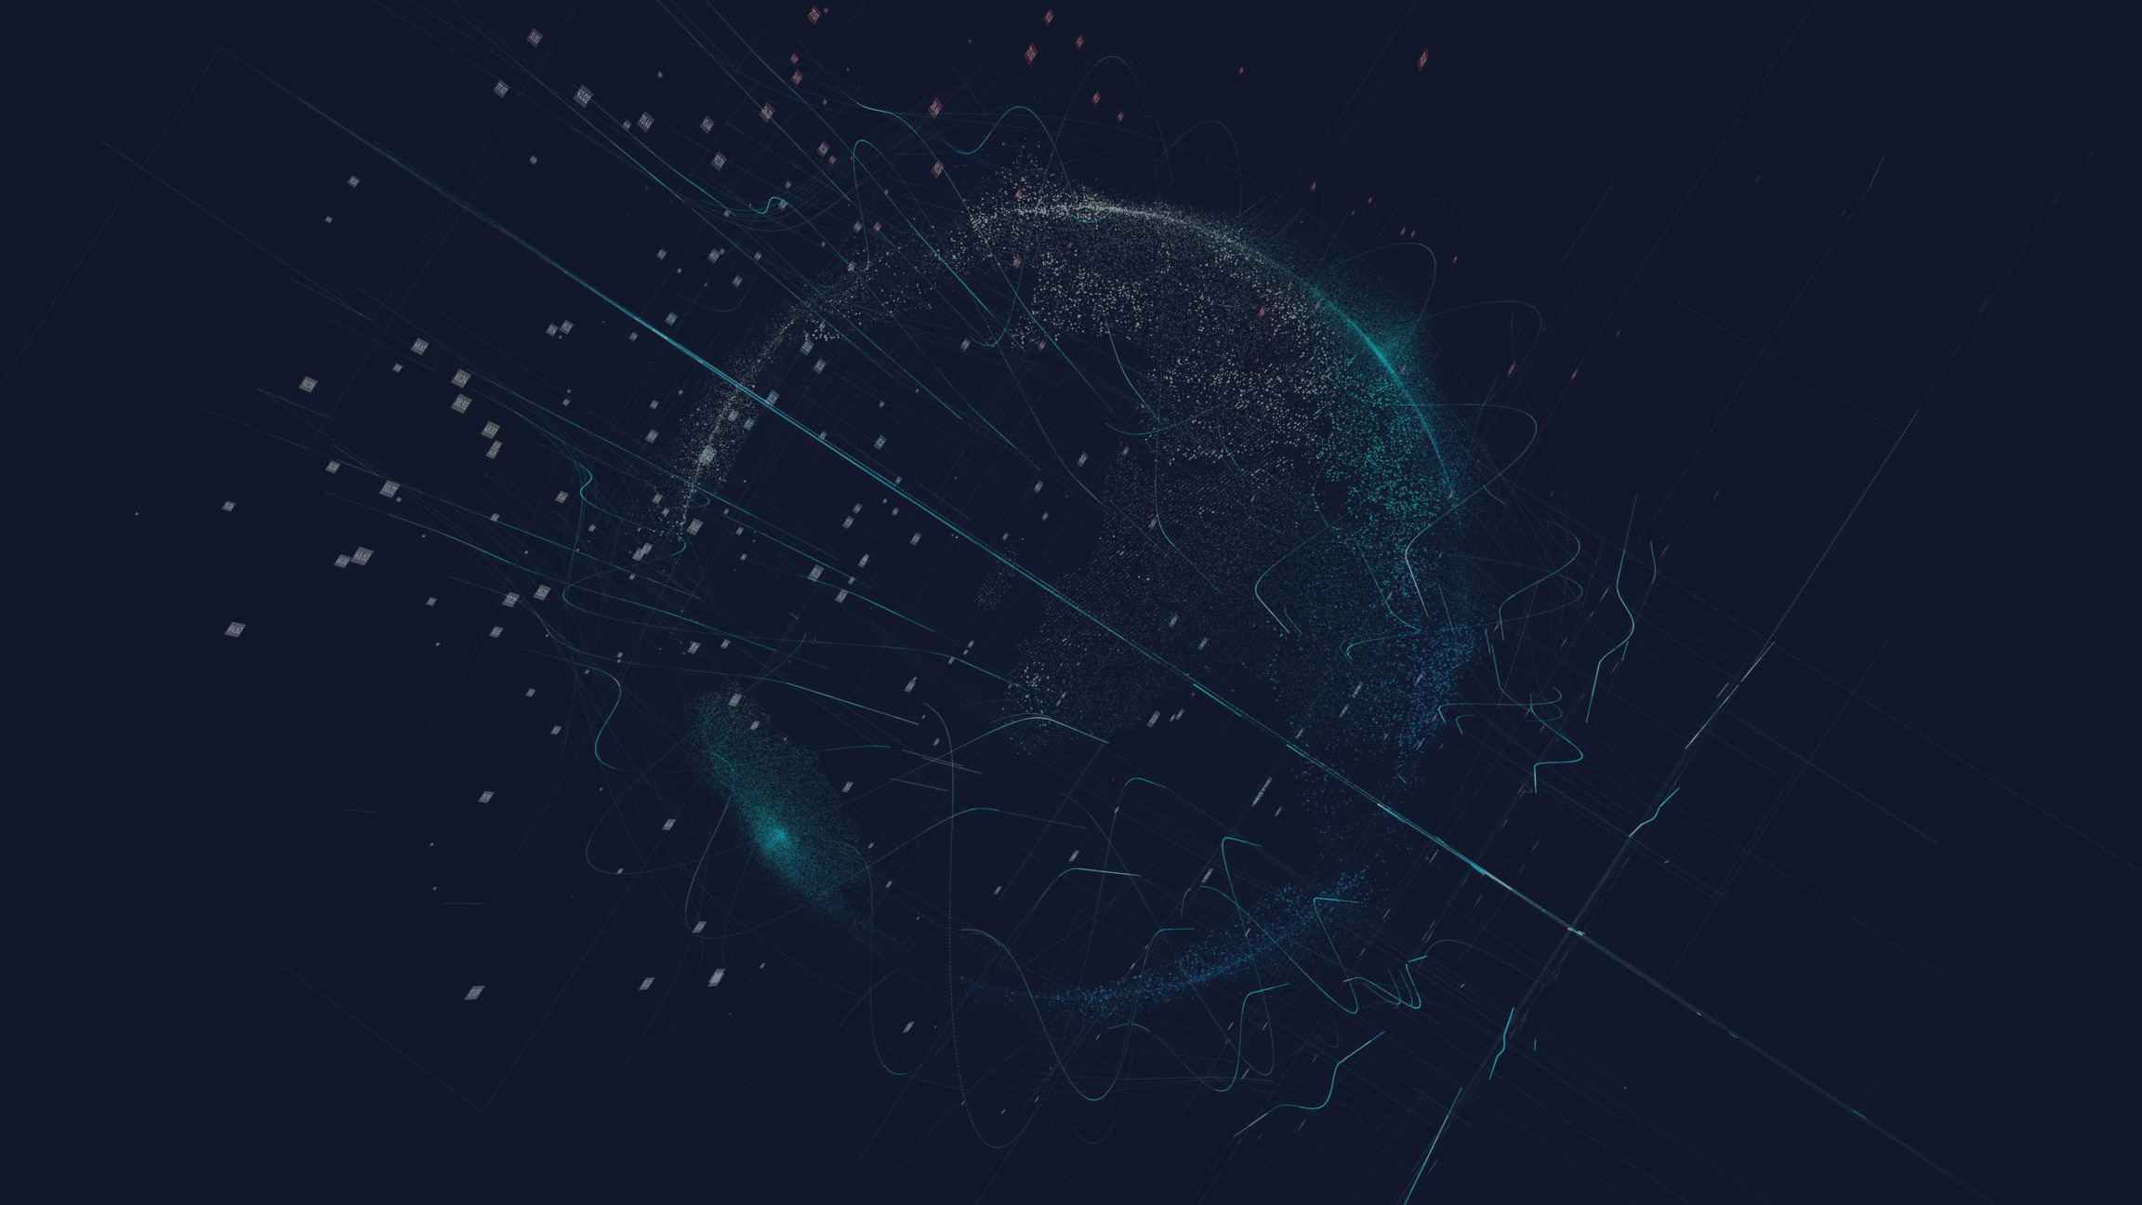
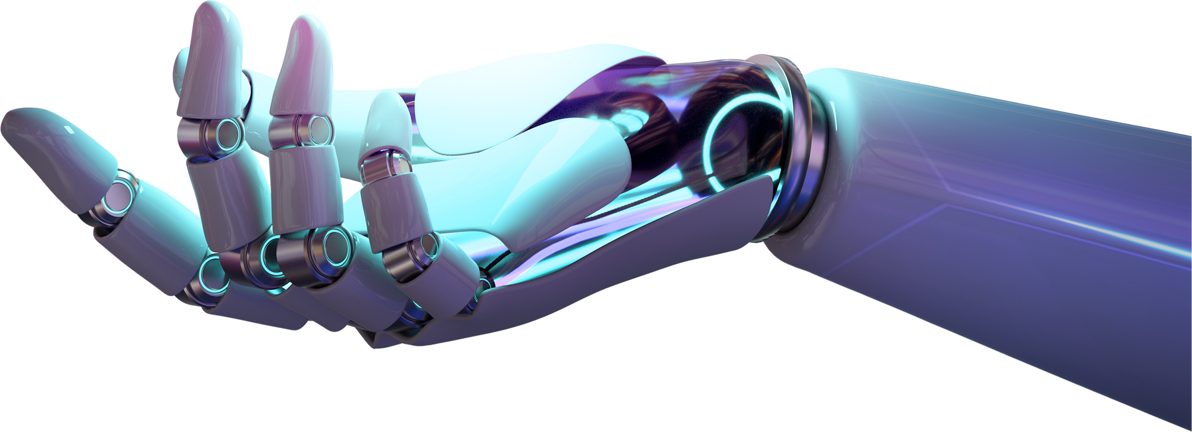
Generative Adversarial Network (GAN)
Archie Tan and Brandon Yan

Slide 2

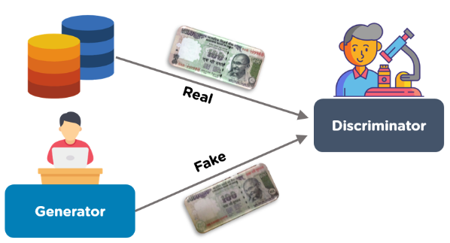
What is GAN

Slide 3


Data Processing
Import TensorFlow GPU and Dataset
Access to the image data and normalize data
Create a Generator and Discriminator
Train both models
Generate Synthetic Data

Slide 4

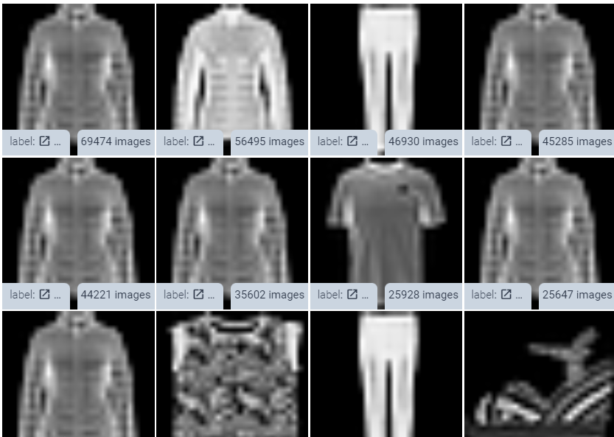
Sample Data
images consisting of a training set of 60,000 examples
Each example is a 28x28 grayscale image.

Slide 5
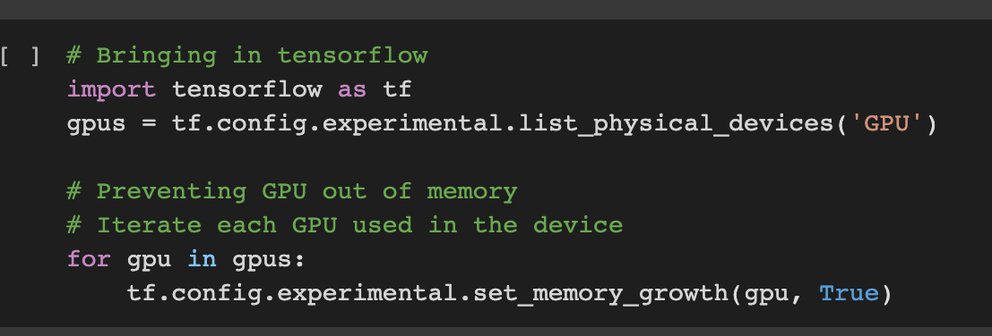

Slide 6
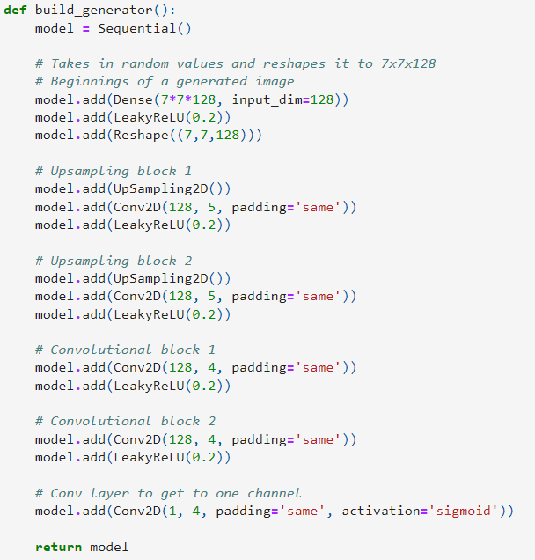
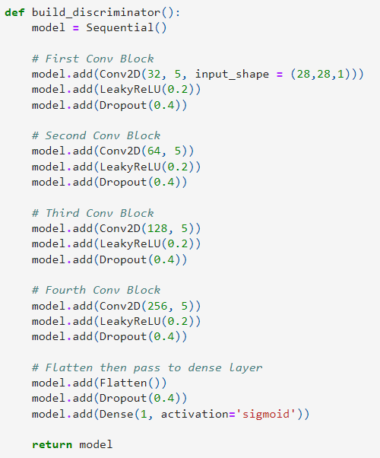

Slide 7
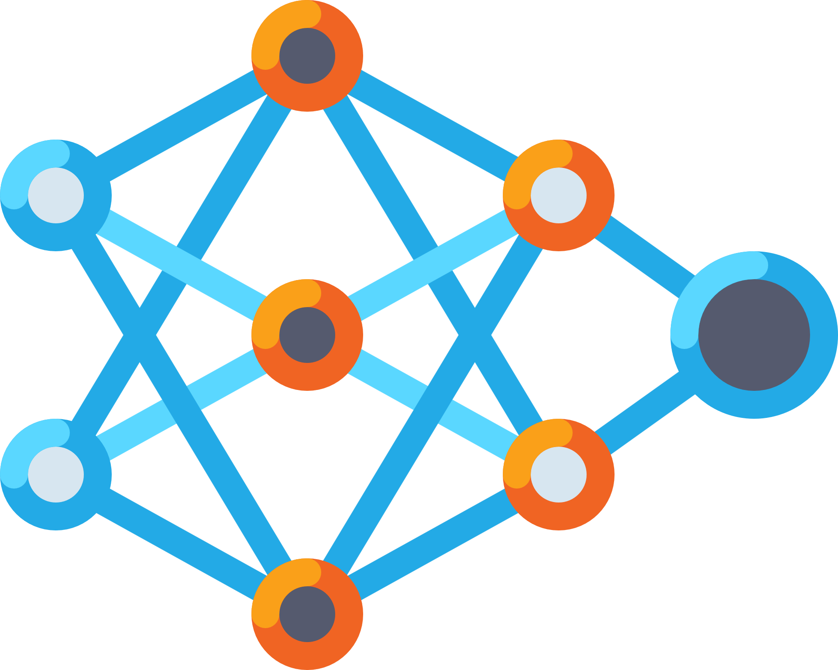
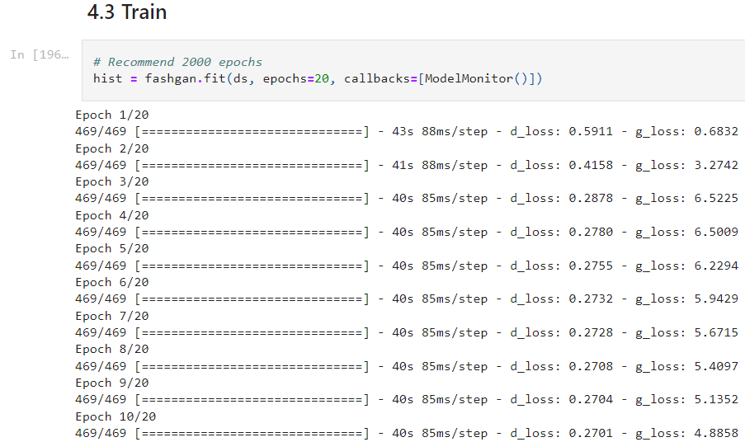
Training

Slide 8
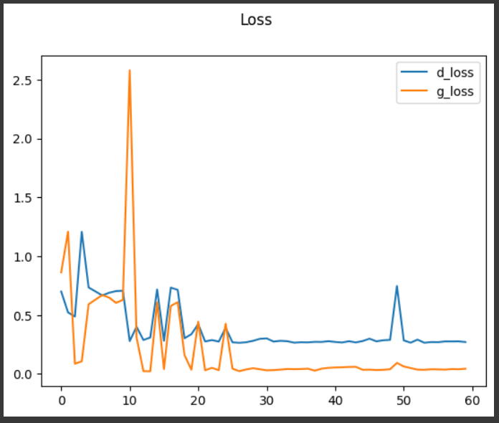
Performence

Slide 9

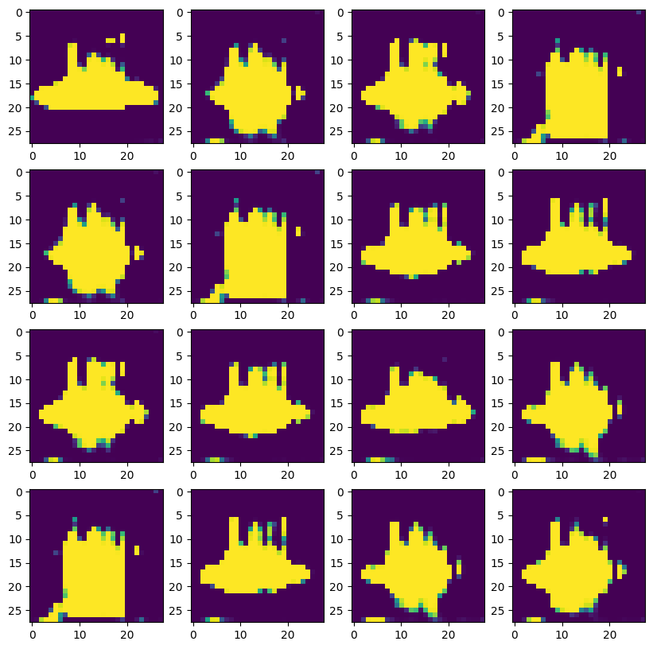
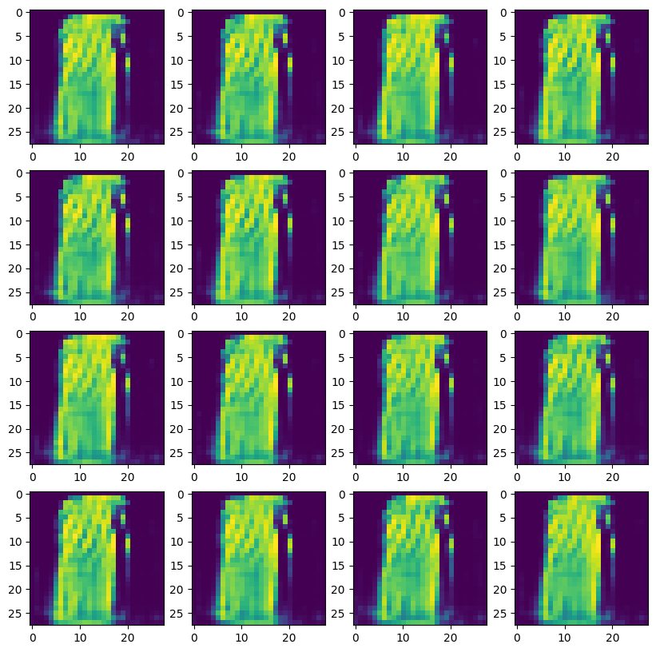
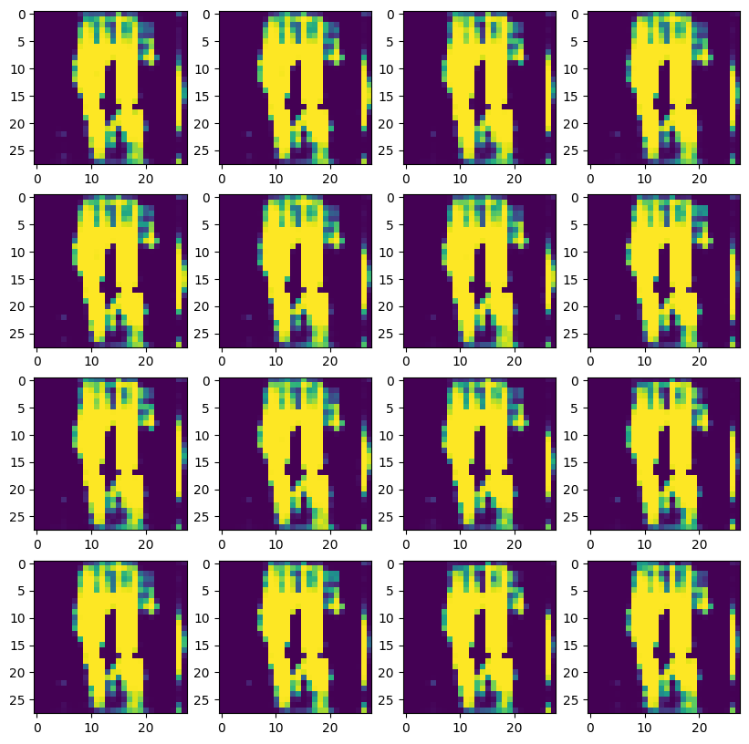
Results
Epochs=20
around 30 mins
Epochs=40
around 1 hr
Epochs=60
around 1.5 hr

Slide 10
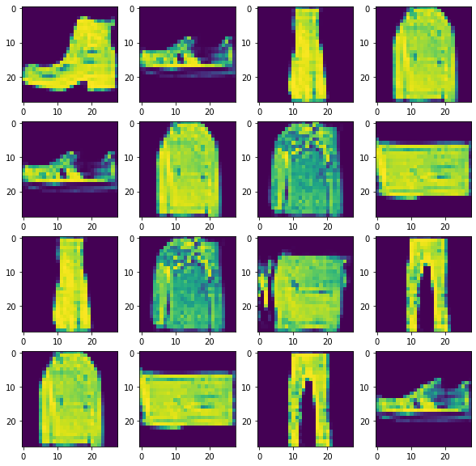
Epochs=2000
Training time: ???

Slide 11
Reference
“Build a Generative Adversarial Neural Network With Tensorflow and Python | Deep Learning Projects.” YouTube, 9 June 2022, www.youtube.com/watch?v=AALBGpLbj6Q
“What Are Generative Adversarial Networks (GANs) | Simplilearn.” Simplilearn.com, www.simplilearn.com/tutorials/deep-learning-tutorial/generative-adversarial-networks-gans.

Slide 12
Thank
you!

